Slide 1

FINAL YEAR MINIPROJECT
SWAMI VIVEKANANDA INSTITUTE OF TECHNOLOGY
Mahbub College Campus, R.P Road,Secunderabad-03
(Autonomous)
2021-25
Department of CSE(Data Science)

Slide 2
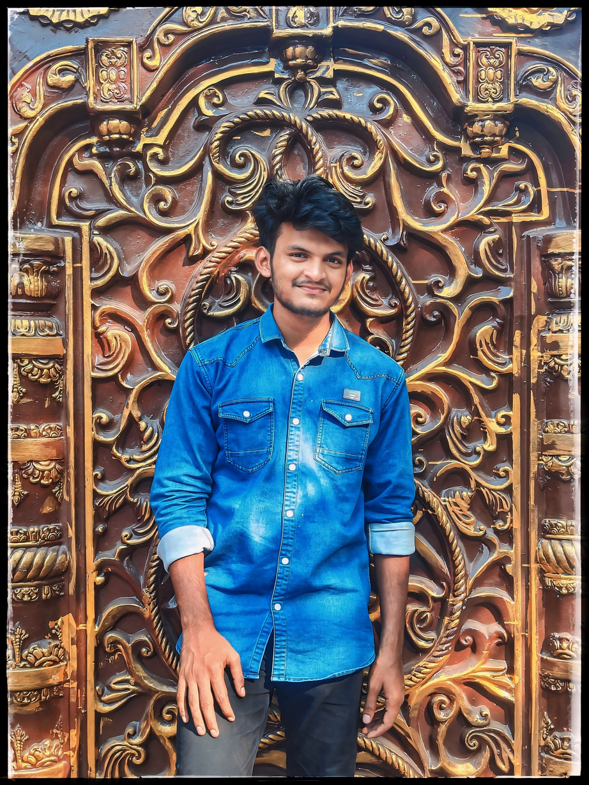
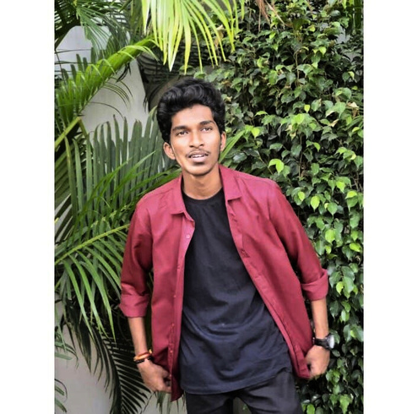
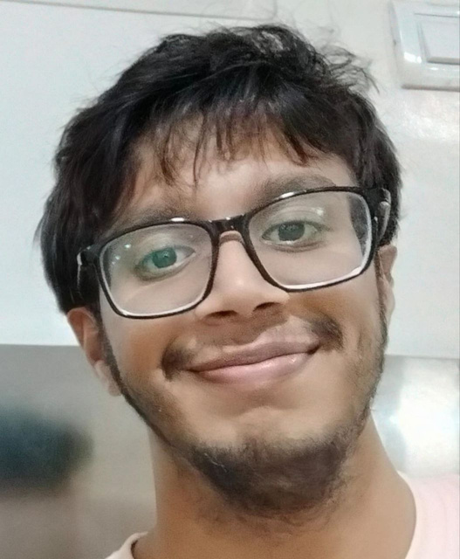
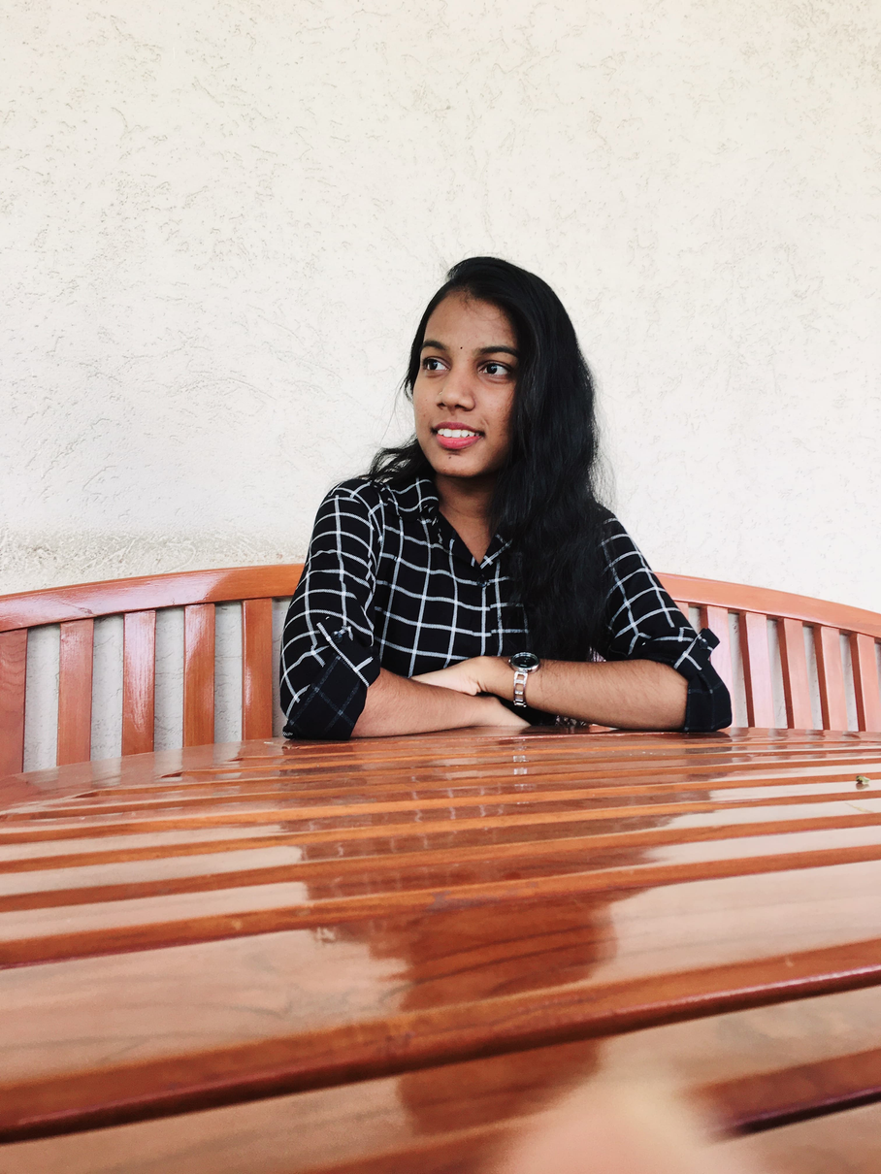

DRIVER DROWSINESS DETECTION SYSTEM
THE TEAM
NITHIN(21P71A6749)
NIKHIL(21P71A6746)
KAUSTUBH (21P71A6728)
PUJITHA
(21P71A6758)
UNDER THE GUIDANCE OF MRS. A. JYOTSNA MAM.

Slide 3


ABSTRACT
Driver drowsiness detection systems are essential in minimizing road accidents caused by driver fatigue.
This paper presents a system designed to detect drowsiness using real-time facial monitoring and alert mechanisms.
The proposed system utilizes Python and OpenCV for image processing, alongside machine learning models for eye and facial landmark detection, which enable the identification of fatigue symptoms such as eye closure and yawning.
This project presents a Python-based driver drowsiness detection system, focusing on real-time facial monitoring to identify signs of fatigue. Utilizing image processing and machine learning, this system tracks eye and mouth movements, such as eye closure duration and yawning, to detect drowsiness.

Slide 4
INTRODUCTION
Driver drowsiness detection systems have become essential tools for enhancing road safety, especially as fatigue-related accidents remain a significant concern worldwide.
Fatigue can impair a driver’s alertness, reaction time, and decision-making, which increases the risk of serious or fatal accidents.
Traditional methods to combat drowsiness often rely on self-monitoring or manual alarms, which can be unreliable and ineffective.
This has driven the development of automated drowsiness detection systems that continuously monitor drivers and provide timely alerts to prevent potential accidents.

Slide 5
EXISTING SYSTEM
The current systems primarily rely on simpler techniques, such as blink rate or eye closure detection, often using traditional algorithms.
These systems may lack flexibility, have lower detection accuracy, and limited functionality for continuous monitoring in varied lighting conditions.
2

Slide 6
PROPOSED SYSTEM
The proposed system combines advanced image processing techniques and machine learning to enhance detection accuracy. Key features include:
Real-Time Eye and Mouth Monitoring: Continuous monitoring of eye closure duration and yawning frequency.
Audio Alerts: Immediate feedback if drowsiness indicators are detected.
Day/Night Compatibility: Utilizing infrared or low-light cameras for detection in all lighting conditions. This system aims to be more adaptable, accurate, and efficient, with applications across personal and commercial vehicle fleets to improve road safety.
2

Slide 7
MODULES:-
Webcam
Detect Drowsy
Image Processing
Face Detection
Eye Detection
Detect Closeness of Eye
Output
Alert

Slide 8
HARDWARE REQUIREMENTS
2
3
1
4
Operating system: Windows, Linux, Mac
Processor : intel i3
Camera
Hard disk : 250GB
Ram: 4 GB

Slide 9
SOFTWARE REQUIREMENTS
Python 3.12 – Core programming language for implementing algorithms.
•Libraries: OpenCV and Dlib

Slide 10
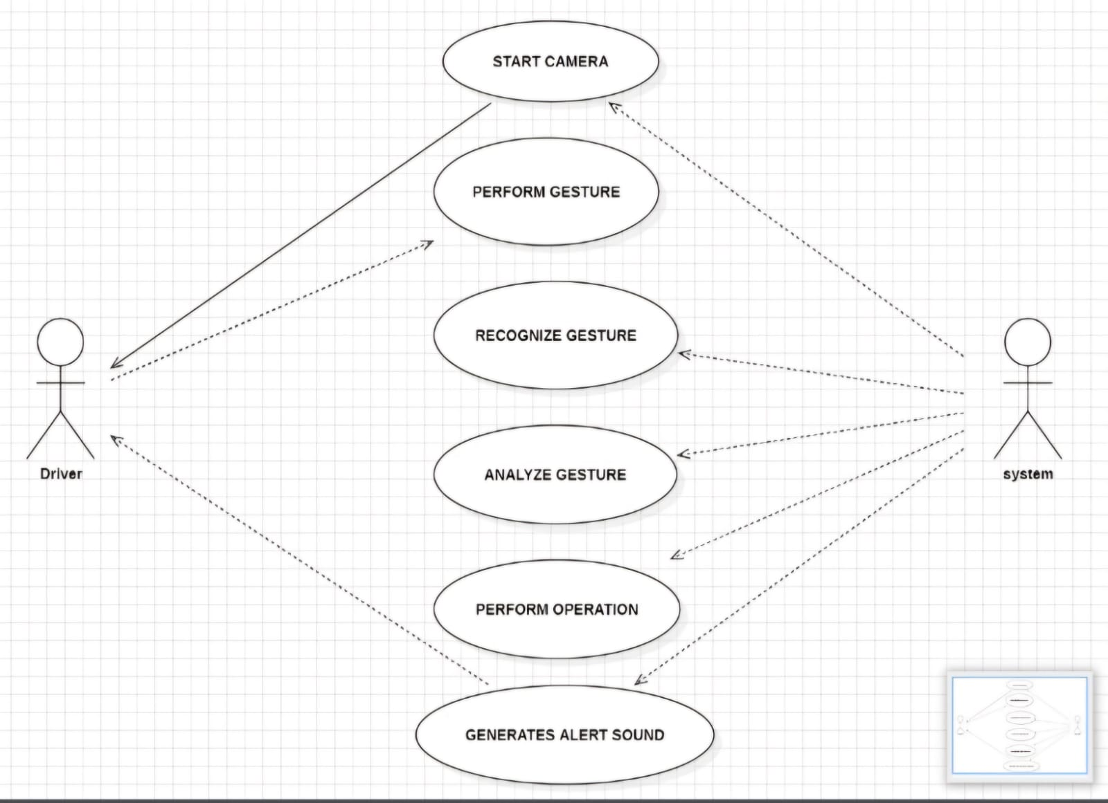
USE CASE DIAGRAM

Slide 11
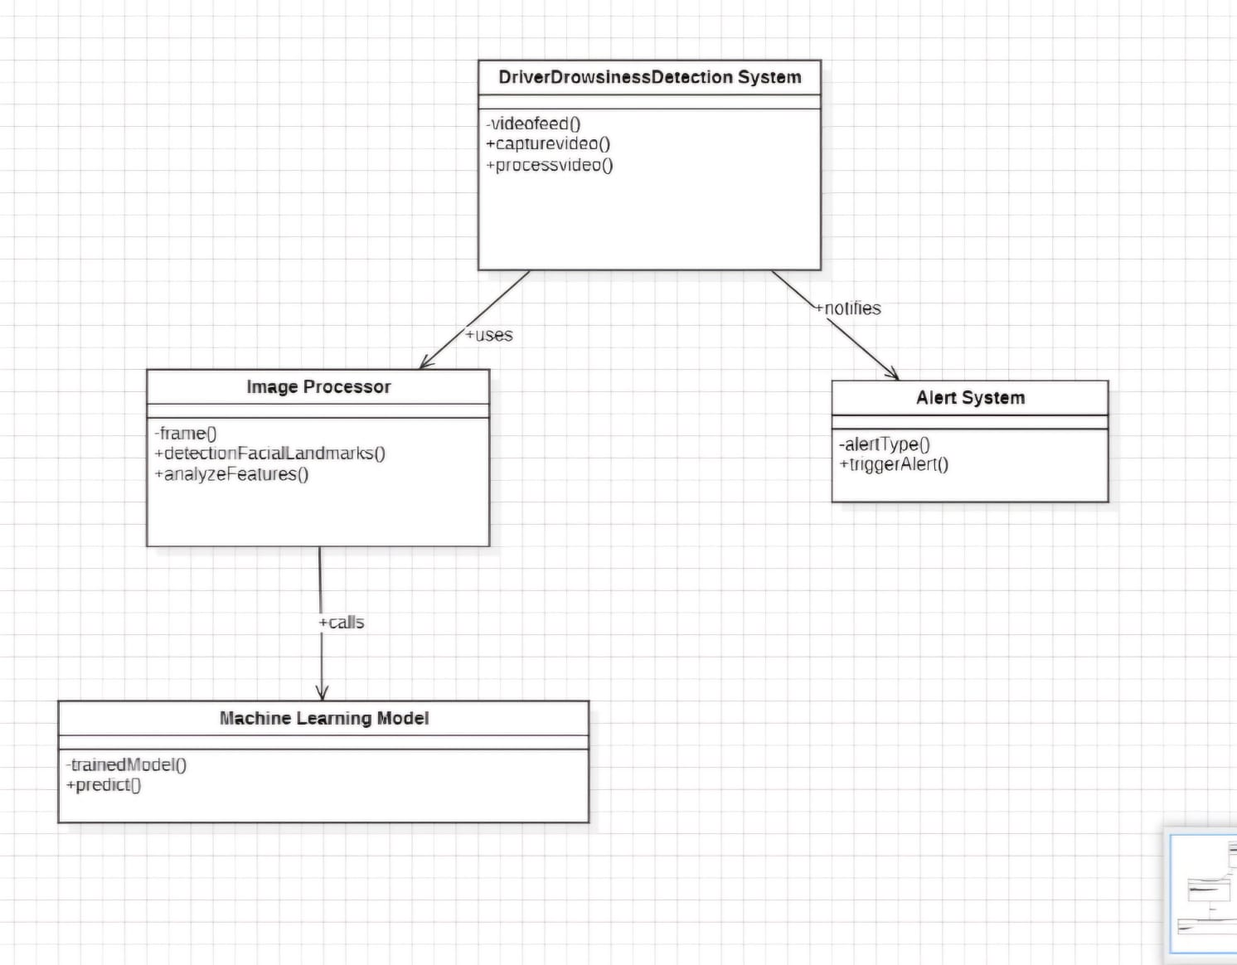
CLASS DIAGRAM

Slide 12
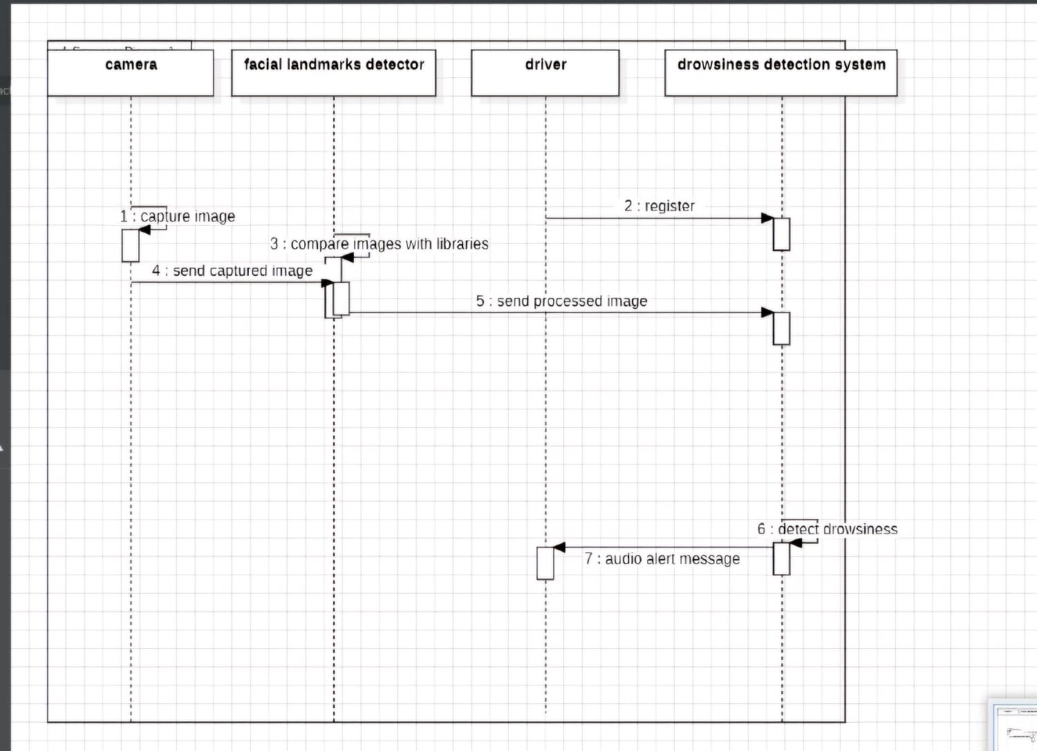
SEQUENCE DIAGRAM

Slide 13
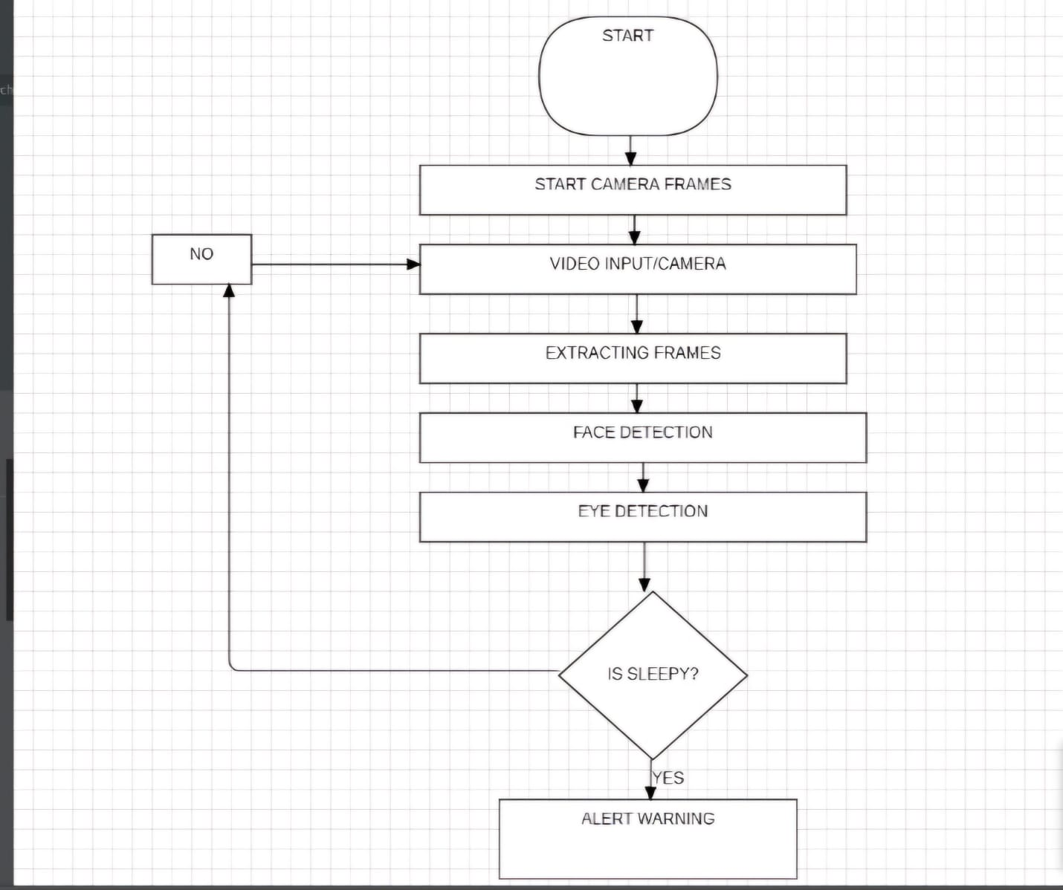
FLOW DIAGRAM

Slide 14
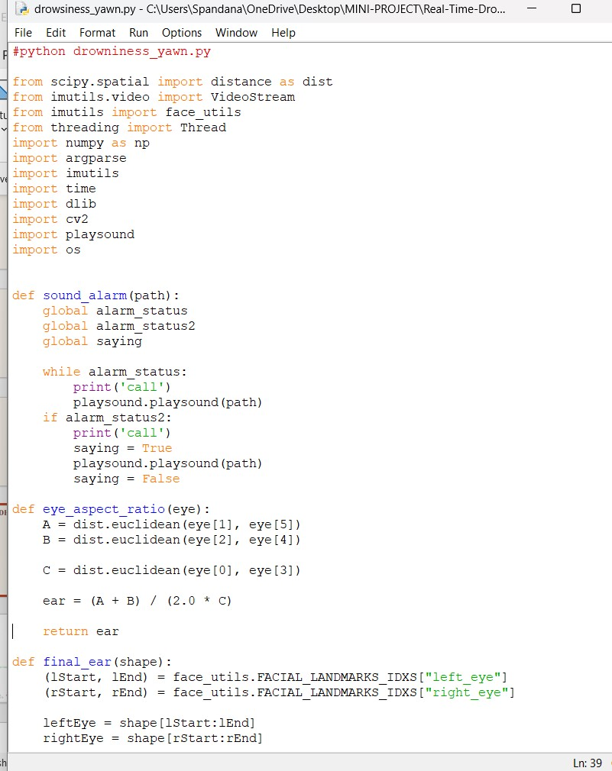
SOURCE CODE:

Slide 15
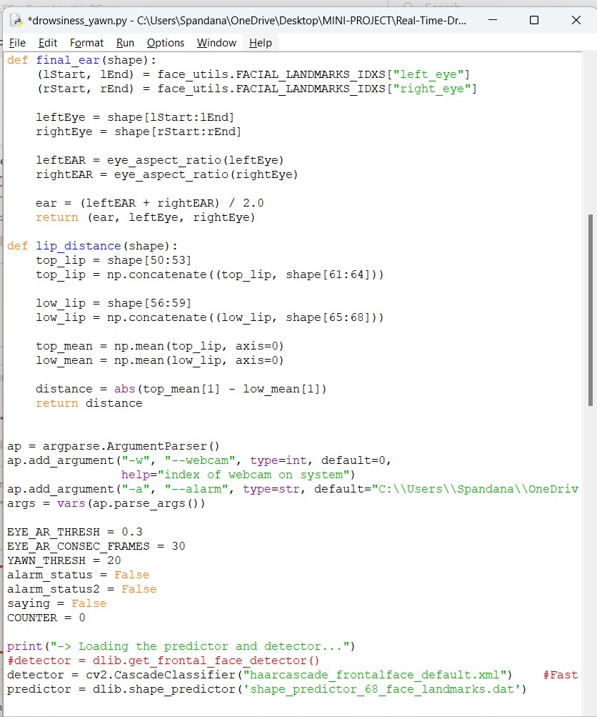

Slide 16
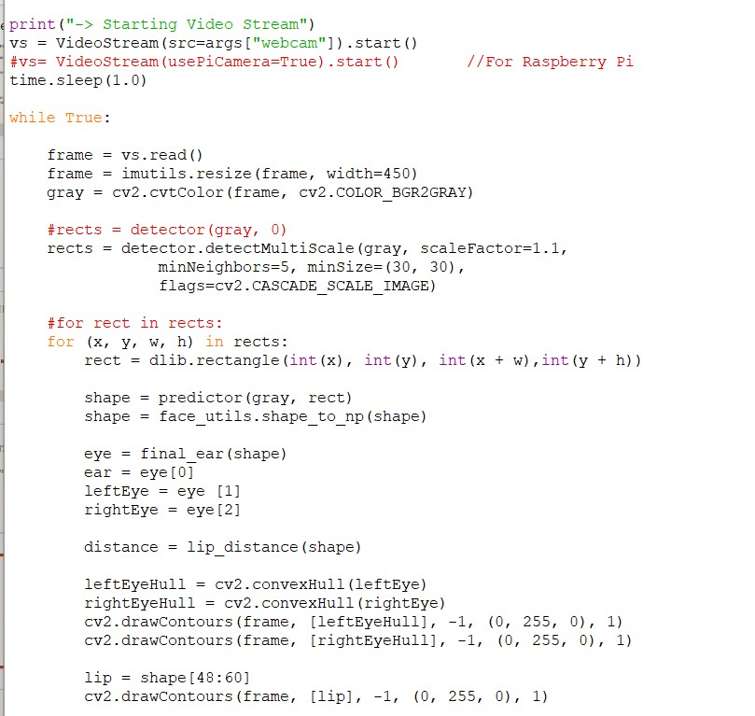

Slide 17
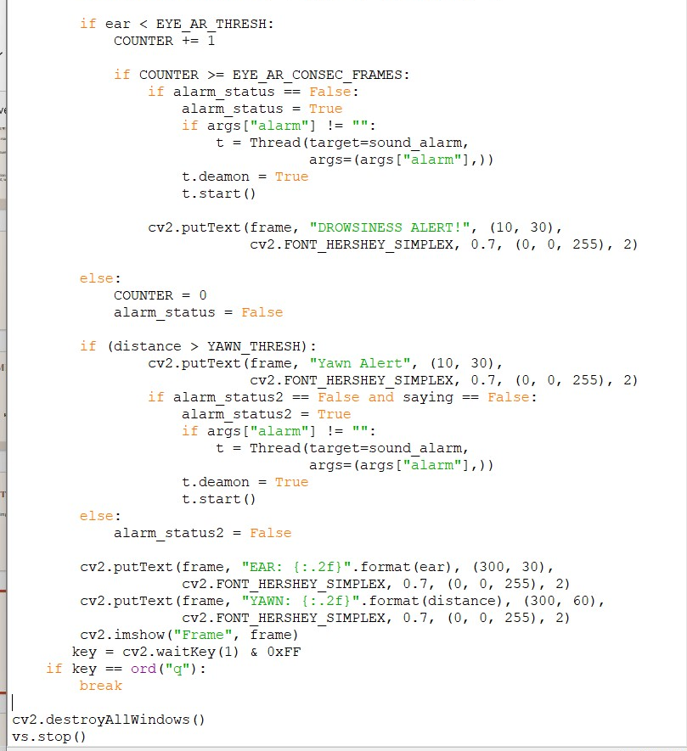

Slide 18
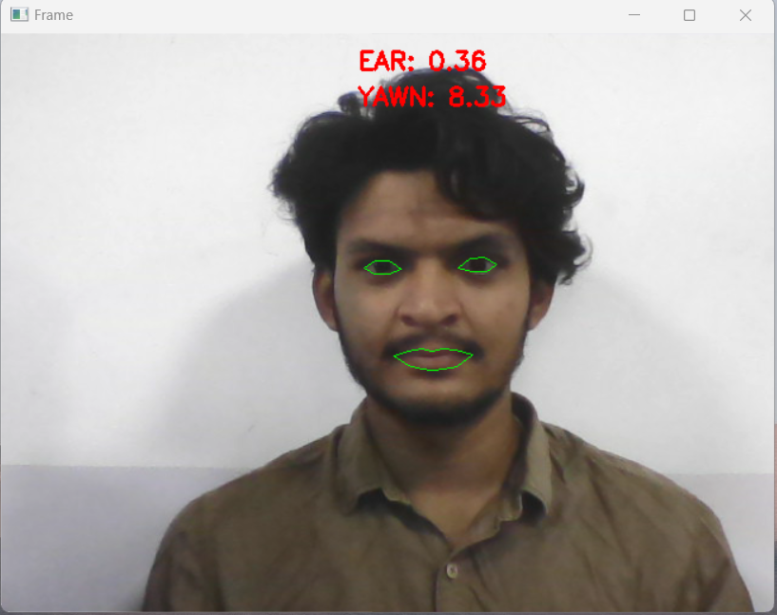
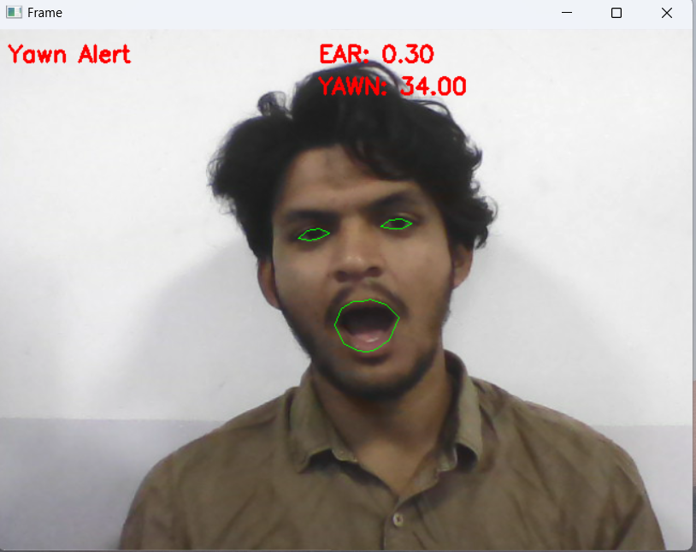
OUTPUT SCREENSHOTS
Normal State
Yawning State

Slide 19
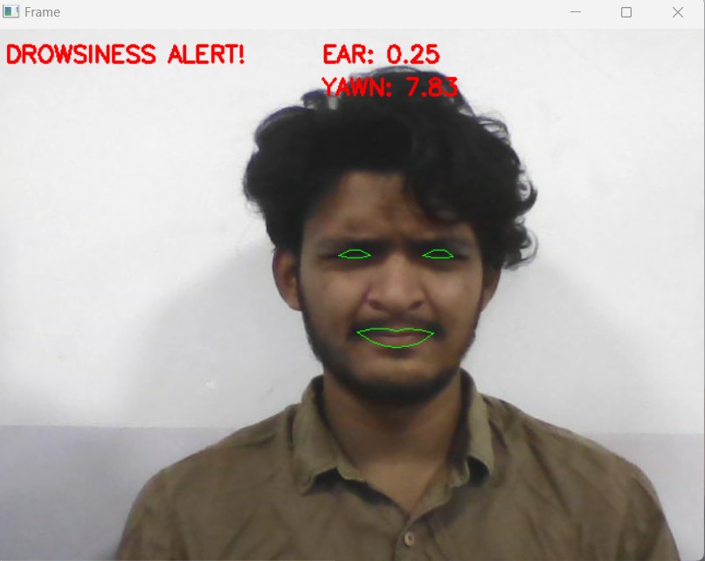
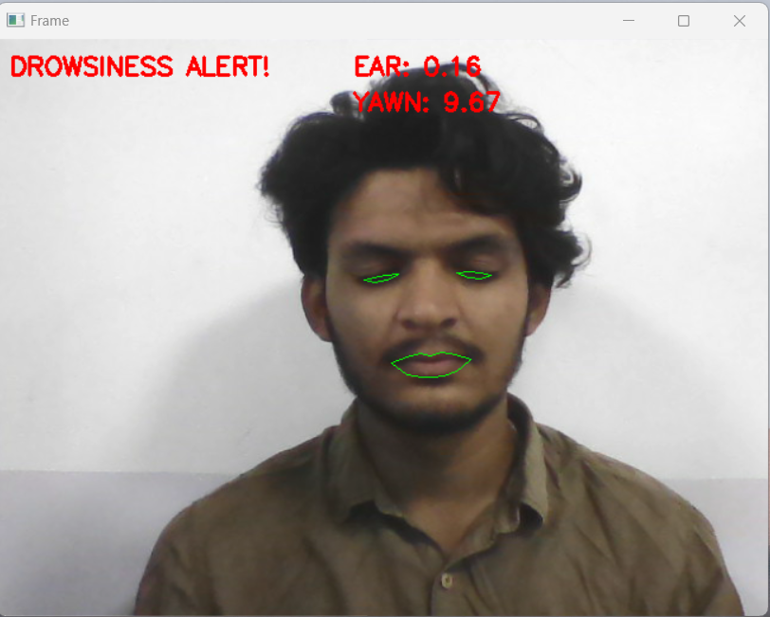
Sleepy/Drowsy State

Slide 20
CONCLUSION
The proposed driver drowsiness detection system represents a significant advancement over existing solutions by integrating real-time image processing, machine learning algorithms, and alert mechanisms
By leveraging cost-effective hardware requirements and adaptable software, this solution is accessible for personal and commercial use, offering a scalable and efficient approach to reducing accidents caused by driver fatigue.
Future enhancements could involve further integration with vehicle systems for automated interventions, making it a proactive tool in promoting road safety and potentially saving lives.

Slide 21

THANK YOU...

